Slide 1
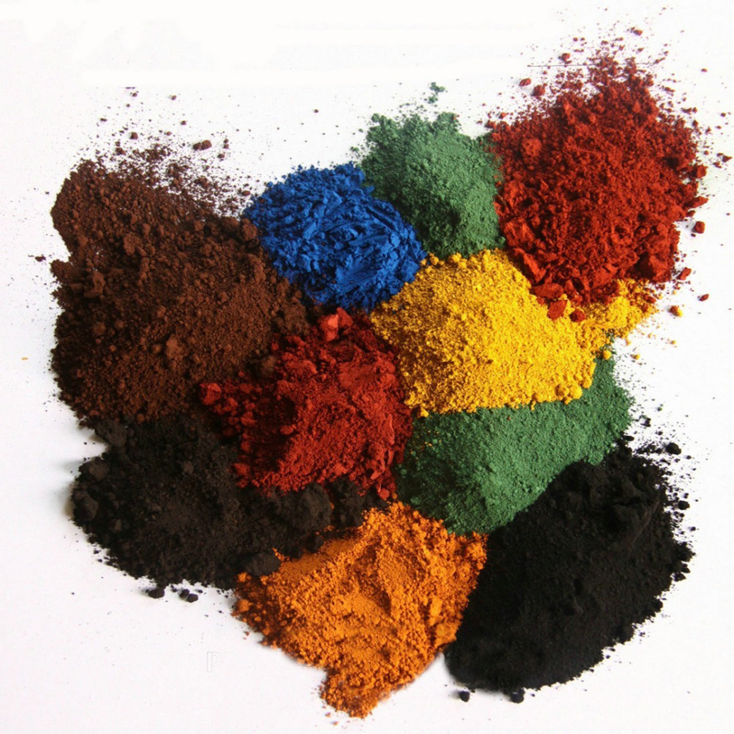
Para Nitro Toluene Ortho Sulphonic Acid Global Market Research Report

Slide 2
Contents
CHAPTER 1 PNTOSA- INDIAN EXPORT
Basic Insights
Worldwide Manufacturers’ Details
Worldwide Buyers’ Details

Slide 3
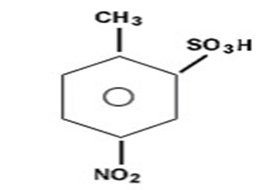
Global Manufacturers & Buyers Details
Basic Insights
Manufacturers Details
Product Applications
Dyes: Acid Orange 19
Intermediates: 4,4-dinitrostilbine-2,2-disulfonic acid
CAS Number- 121-03-9
Physical Appearance- Light brown to Off White Wet Cake
Worldwide Manufacturers:**
Total Production Volume: **** MT
Country Involved
China
India
United Kingdom
Synonyms
Buyers Details
o-Toluenesulfonic acid
5-nitro- (6CI,7CI,8CI)
4-Nitro-2-toluenesulfonic acid
5-Nitro-o-toluenesulfonic acid
NSC 9580
PNTOS
p-Nitrotoluene-o-sulfonic acid
Worldwide Buyers: 28
Buying Countries: 13
Country Involved Canada, US, UK, Korea, Japan, France, Indonesia, Canada, Spain, Taiwan, Thailand, Turkey & Mexico
Chemical Structure
All details available in embedded excel sheets

